Slide 1
Arkansas’ Journey to Multiple Measures
Mason Campbell, Arkansas Division of Higher Education (ADHE)
Dr. Erin Finzer, University of Arkansas Little Rock (UALR)
Tracy Harrell, Arkansas Division of Higher Education (ADHE)
Dr. Ricky Tompkins, Arkansas Community Colleges (ACC)

Slide 2
Where We Began
Guided Pathways for Degrees
15 to Finish

Slide 3
Where We Are Now
Developmental Redesign
Alternative Math Pathways
Multiple Measures for Placement

Slide 4
State Placement Policy
2012 Policy Changes
2017 Policy Changes
Opened the door for "other criteria" to be used in placement testing procedures
Updated ACT benchmarks
Expanded definitions
Allowed for "simultaneous enrollment in college-level credit and developmental courses"
Administration of any campus may elect to set minimum scores for enrollment in college-level coursework
Arkansas Higher Ed Coordinating Board will set minimum scores for simultaneous enrollment
Allows exams, previous coursework, or other criteria
Placement assessment should reflect a better than 75% likelihood of the student’s ability to earn a “C” or better grade in the course in which the student is placed.
Placement scores must be submitted for purposes of admission and course placement

Slide 5
Is Arkansas Really THAT Different?
Survey of Departmental Leadership at 2-Year and 4-Year Colleges in Arkansas to Identify Mathematics Competencies Necessary for Student Success in Non-STEM Disciplines
By Fall 2018, 31 public institutions implemented mathematics pathways
In 2021, Arkansas partnered with the Center for the Assessment of Postsecondary Readiness (CAPR) for a 3-year project focused on capacity building and scaling the adoption of MMA in Arkansas.
Original Math Pathways Research begins in 2015
Work continues to expand the acceptance of Quantitative Literacy in Non-STEM degree programs
Task Force Recommendations & Productivity Funding Model in 2017

Slide 6
Multiple Measures Assessment (MMA)
Data Sources
Sample
All students who enrolled in college-level math in last 5 years.
All students who enrolled in college-level English in last 5 years.

Slide 7
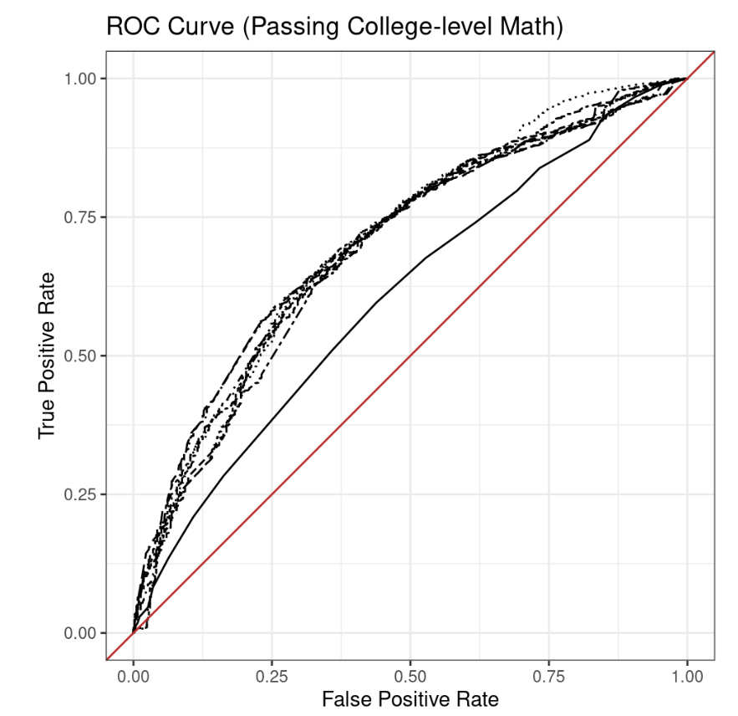
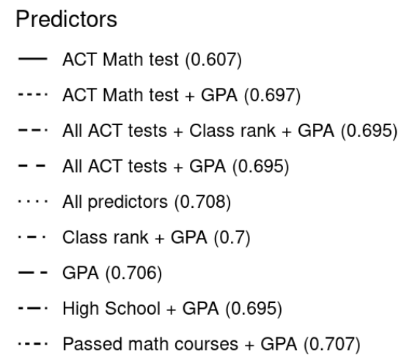
MMA Predictive Analysis

Slide 8
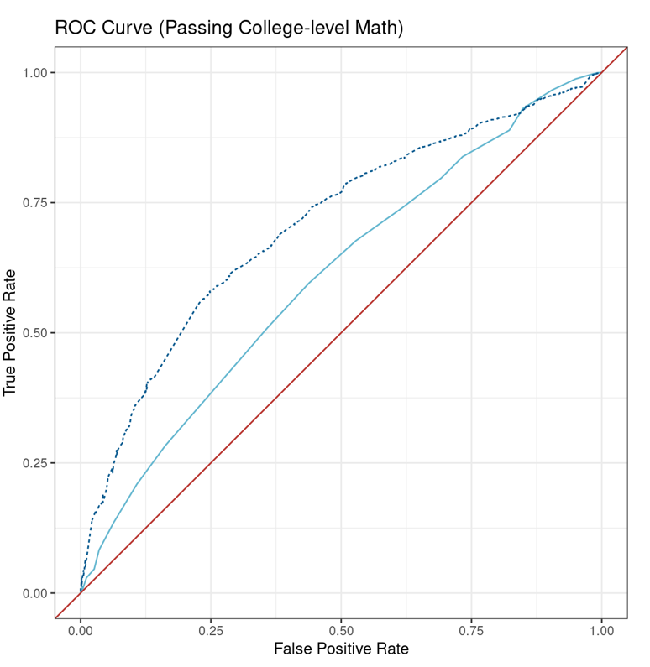
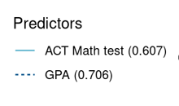
MMA Predictive Analysis

Slide 9
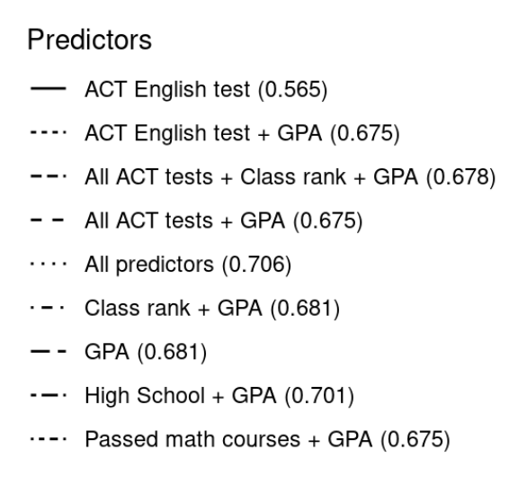
MMA Predictive Analysis

Slide 10
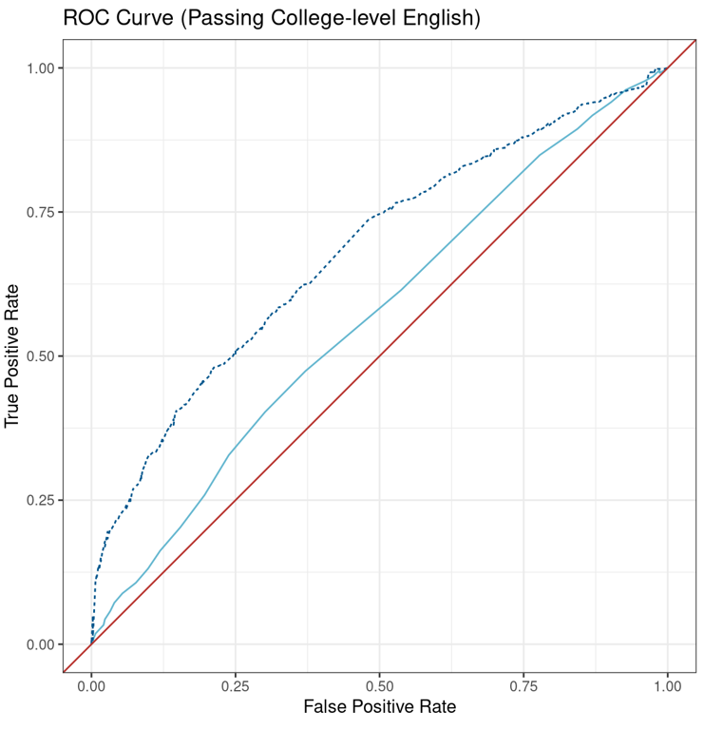
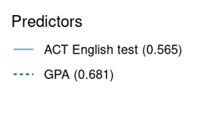
MMA Predictive Analysis

Slide 11
MMA Recommendations
A student who presents a HS GPA of 2.5 or higher should be considered college-ready and permitted to enroll in college-level Reading, Writing and English courses without a developmental prerequisite. ​
Lower minimum HS GPA score(s) for placement into developmental courses are allowed.
A college or university may also establish different prerequisites for placement into higher-level courses.​
Self-reported HS GPA should be accepted in the absence ​of an official GPA from a transcript.
High school students participating in college or university courses must meet the existing placement policy for concurrent enrollment students.
GPA remains an excellent predictor of student performance for at least 10 years after graduation.
Colleges may allow students without a reportable or valid cumulative HS GPA to register for courses up to and including the college-level gateway course based on advising.

Slide 12
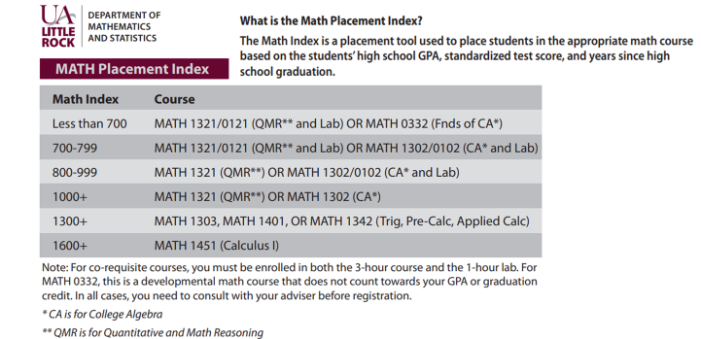
Institutional Implementation

Slide 13
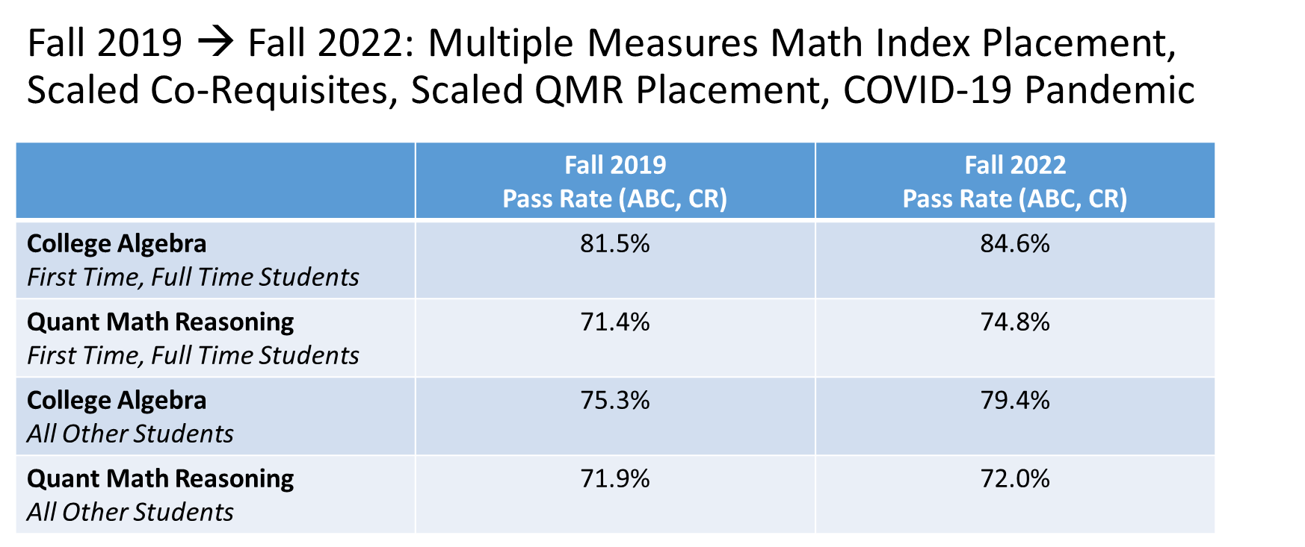
UA Little Rock Student Outcomes: % Pass Rate (Final Grades of A,B,C or CR)

Slide 14
UA – Little Rock Institutional Implementation

Slide 15
Arkansas’ Journey to Multiple Measures
Mason Campbell Arkansas Division of Higher Education mason.campbell@adhe.edu | Dr. Erin Finzer University of Arkansas Little Rock esfinzer@ualr.edu
Tracy Harrell Arkansas Division of Higher Education tracy.harrell@adhe.edu | Dr. Ricky Tomkins Arkansas Community Colleges rtompkins@arkansascc.org

